Slide 1

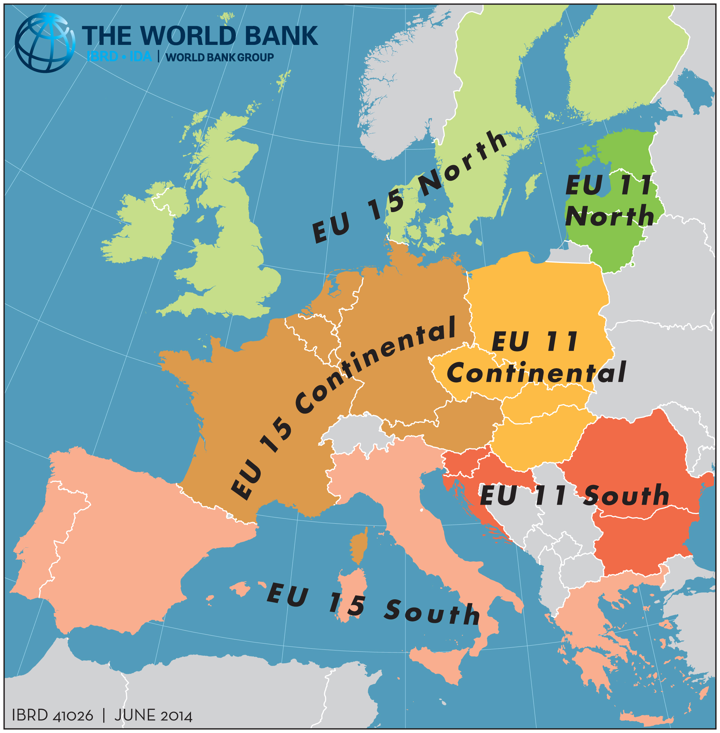
Bulgaria Economic Forum
Theo Thomas,
Lead Economist

Slide 2
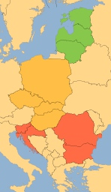
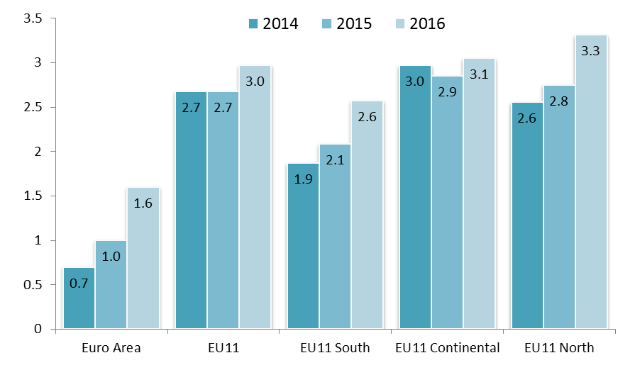
Sluggish recovery, with diversity across in Europe
GDP growth in 2014
1.9
GDP growth (percent)
2.5
2.9
3.2
2.5
2.4
3.2
2.6
2.6
-0.5
Source: Ameco, European Commission; World Bank staff estimates
1.4

Slide 3
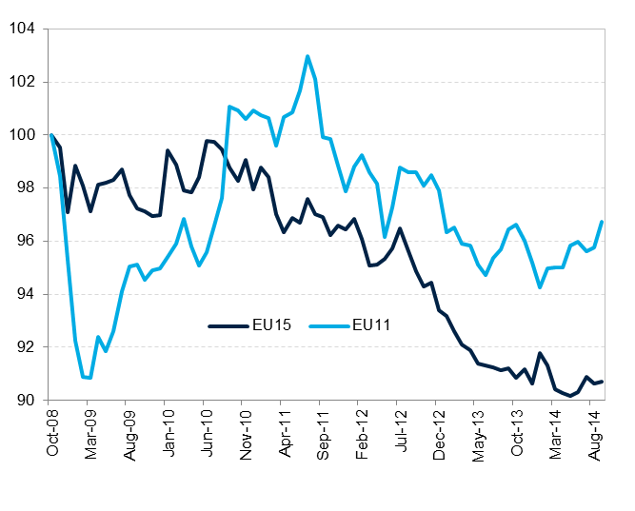
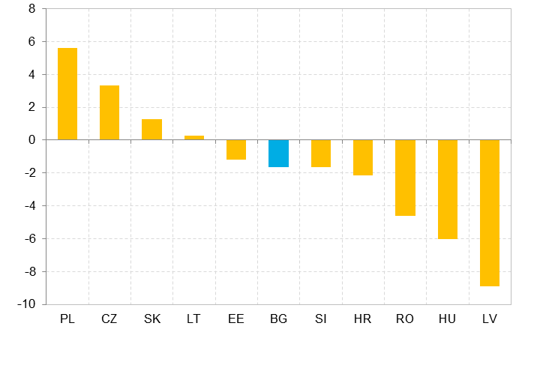
Access to credit will be critical for new investment, but foreign deleveraging continues
Investment was further damped by sluggish bank lending, and by rising real interest rates as inflation approached zero or even turned negative
Real Credit Growth, EU11 and EU15
Index October 2008 = 100
Change in Total International Claims by Country,
2nd Quarter of 2013 to 2nd Quarter of 2014 (Billions of EUR)
Source: European Central Bank; World Bank staff calculations

Slide 4
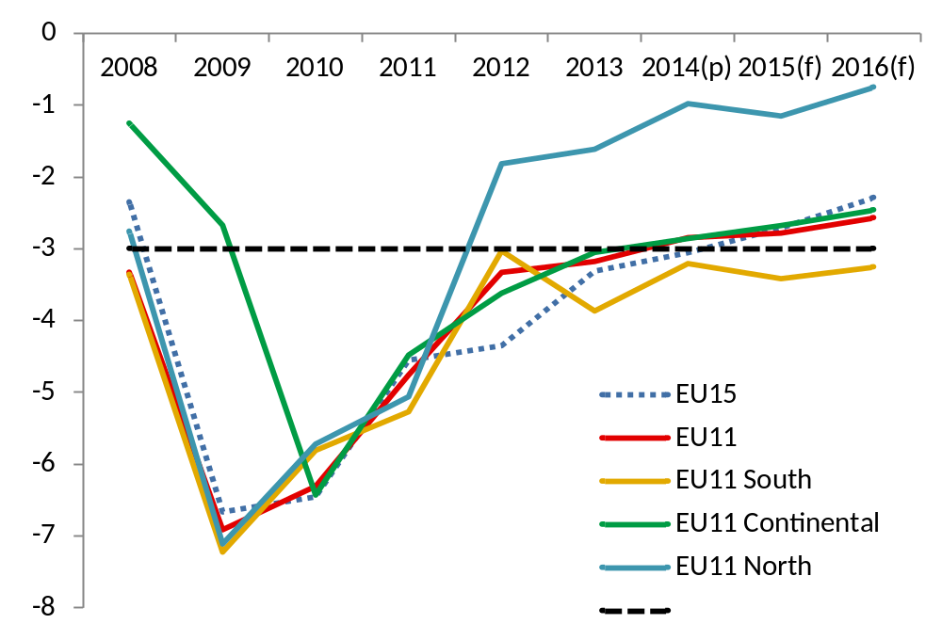
As the pace of fiscal consolidation slows, the focus will be on the quality of spending
Fiscal deficit, percent of GDP
Source: World Bank staff forecasts based on European Commission, Winter Forecast, 2014

Slide 5
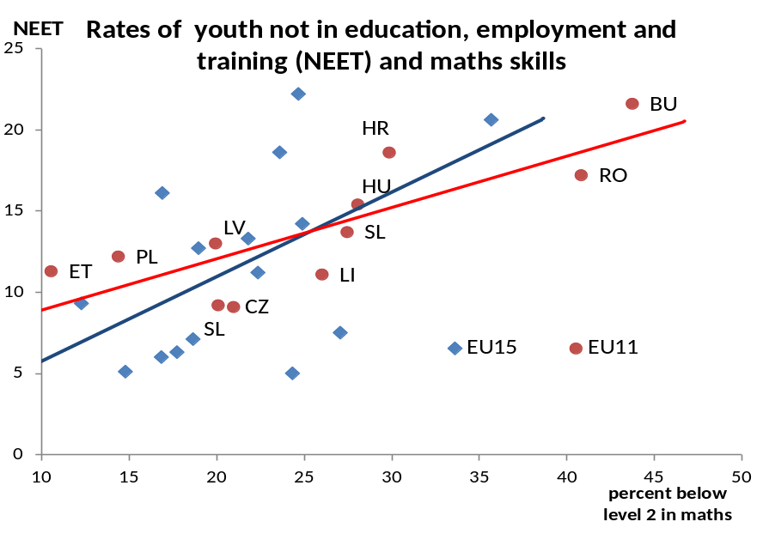
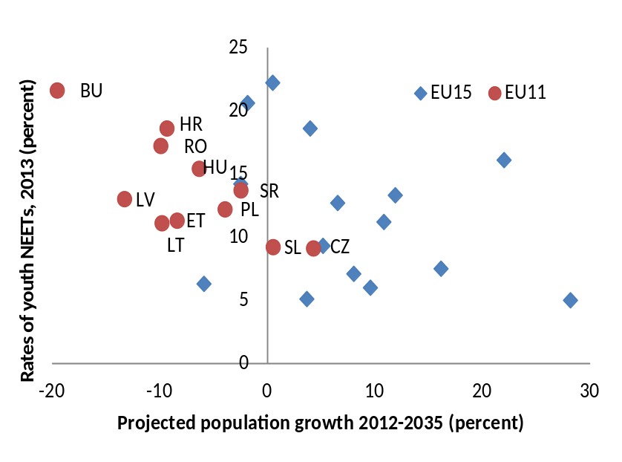
While youth and low-skilled continue to be most scarred by the poor labor markets
EU11 countries are ageing rapidly, while youth inactivity rates are high…..
…and often associated with low skills
Source: Eurostat, UN and authors calculations

Slide 6
MACROECONOMICS AND FISCAL MANAGEMENT
For more information about the World Bank Group in Europe and Central Asia, please visit: www.worldbank.org/eca
or on Facebook at: https://www.facebook.com/WorldBankEuropeCentralAsia

